Slide 1
3D Real-time Indoor Localization via Broadband Nonlinear Backscatter in Passive Devices with Centimeter Precision
MobiCom ’16
Yunfei Ma, Xiaonan Hui, Edwin C. Kan
Speaker: Wang Shenpeng
Student ID: 118033910120

Slide 2
Introduction
Radio Frequency Identification (RFID)
Use passive tag responding to reader. Provide information such as identification and position.
Main components of RDIF
Tags
Readers

Slide 3
Present problems
The ambiguous phase cycles
Self-jamming and bandwidth limitation
Large phase error induced by multi-paths:

Slide 4
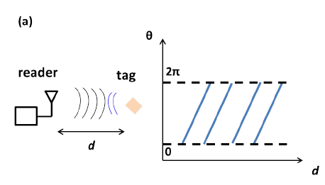
Ambiguous phase cycles
Since the measured phase is always within [0, 2π), cycle ambiguity exists when the distance is longer than one wavelength.
When the measured phase is θ, the actual phase can be θ+2nπ where n is the cycle integer.
The cycle integer must be solved correctly in order to reduce ambiguity in the 3D location.

Slide 5
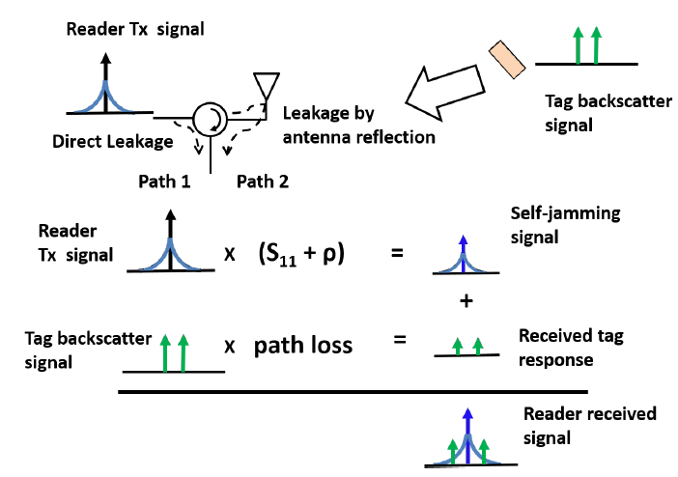
Self-jamming and bandwidth limitation
Two mainly leakage signals
Direct leakage
Reflection from antenna
Bode-Fano criteria

Slide 6
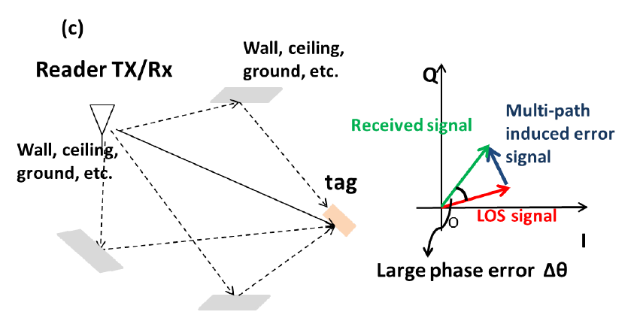
Phase error induced by multi-paths
Multi-paths will cause large
phase error, Which will also
leads to ambiguous phase
cycle.

Slide 7
Nonlinear backscatter localization system

Slide 8
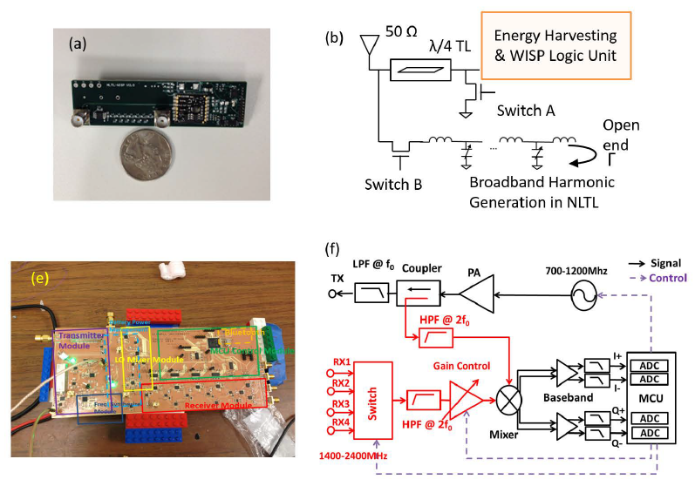
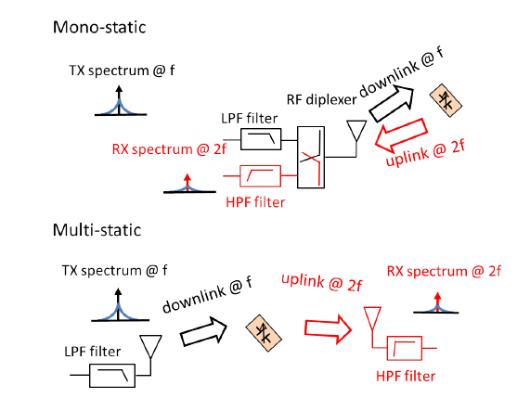
Self-jamming elimination
Produce second or higher-order harmonics passive respond
Use LPF/HPF to filter selected frequencies.

Slide 9
HMFCW Ranging Algorithm
They prove that when , the n can be 100% reliable.
They prove that
So, when the bandwidth is unlimited, the tolerance of multi-path phase error can be very large (about -45°~45°）

Slide 10
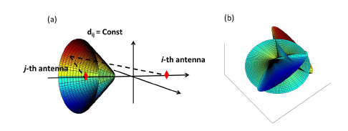
3D Localization Algorithm
each ranging result is a differential distance from a tag to two Rx antennas at different position, in 3D space, one differential distance measurement gives a hyperboloid.
Solve the problem with
Fletcher-Reeves
nonlinear conjugate gradient (CG) method.

Slide 11
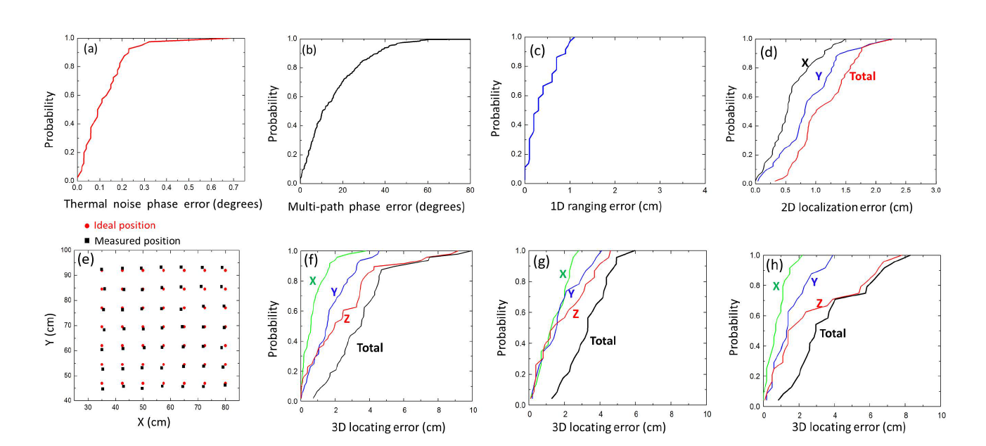
Results

